Slide 1
Introduction to GitHub
Sardar Vallabhbhai Patel Institute of Technology (SVIT), Vasad
MCA Department
COSMOS Lecture Series
Academic Year: 2019-20
[ODD SEMESTER]
27-Jul-201p
By Rinku Chavda

Slide 2
Agenda
What is Git & Github ?
Github Structure
Important Concepts for Github Users
Understanding Github workflow
Example : HelloWorld

Slide 3
What is Git & Github ?
Git (global information tracker) is a distributed version-control system for tracking changes in source code during software development. It is designed for coordinating work among programmers, but it can be used to track changes in any set of files. Its goals include speed, data integrity, and support for distributed, non-linear workflows.
Git is an example of version control. Version control is a system that records changes to a file or set of files and helps us recall specific versions later if needed. It allows you to :
Revert files or the whole project to an earlier state
Compare changes over time
See who modified what?
Control modifications by collaborators with the permission of admin/owners

Slide 4
What is Git & Github ?
Github is a repository hosting service for Git.
GitHub is a code hosting platform for version control and collaboration. It lets you and others work together on projects from anywhere.
GitHub is an American company that provides hosting for software development version control using Git. It is a subsidiary of Microsoft
While Git is a command line tool, GitHub provides a web-based graphical interface that works on top of GIT. It can also be treated as a social platform to share knowledge and work.
It also provides access control and several collaboration features, such as wikis and basic task management tools

Slide 5
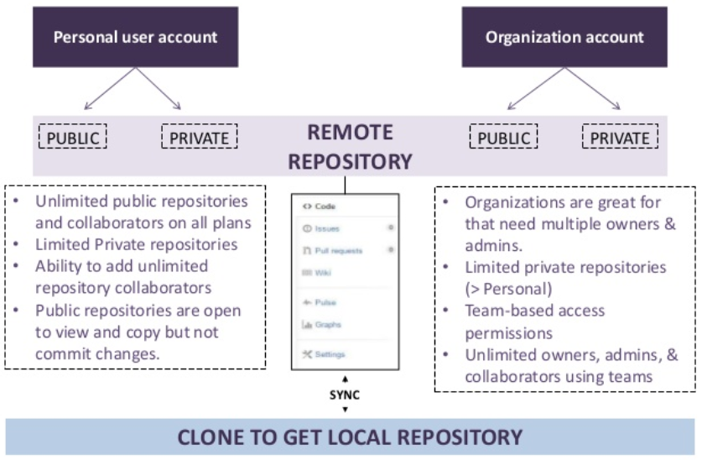
Github Structure

Slide 6
Important Concepts for Github Users
Creating a repo
Creating a repository for multiple people to work together
Master in a repository
This is the final version that is considered ready to use by anybody in the team or outside if repository is public.
Creating a Branch
Create a branch in your project, for an environment where you can try out new ideas.
Changes you make on a branch don't affect the master unless pull request is accepted.
Changes committed to branch reflects for you to keep track of different versions
Adding Commits
Keeps track of your progress as you work on a branch or master.
Creates a transparent history that others can follow to understand what you've done and why.

Slide 7
Important Concepts for Github Users
Pull requests
Pull Requests initiates discussion about your commits or changes made to a code.
See exactly what changes would be merged if pull request is accepted.
Issues
Highlight bugs or issues with codes that need rectification
Issues remain open unless resolved.
Can be filtered, Can be labeled as bug/enancement/ question/help wanted etc
Forking a repository
It creates a copy for you to work on independently without any changes to theirs.
Submit a pull request to owner so that the owner can incorporate changes.

Slide 8
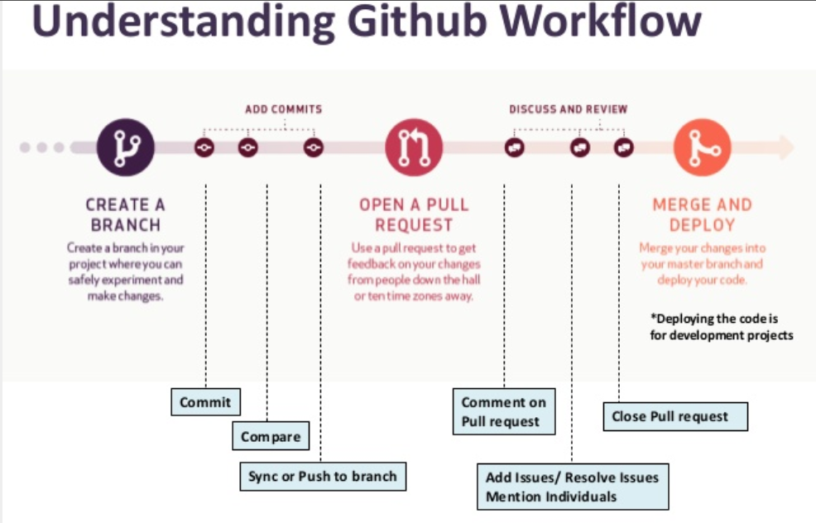
Understanding Github workflow
https://guides.github.com/introduction/flow/

Slide 9
Create a Repository
A repository is usually used to organize a single project. Repositories can contain folders and files, images, videos, spreadsheets, and data sets – anything your project needs
GitHub makes it easy to add one at the same time you create your new repository. It also offers other common options such as a license file.

Slide 10
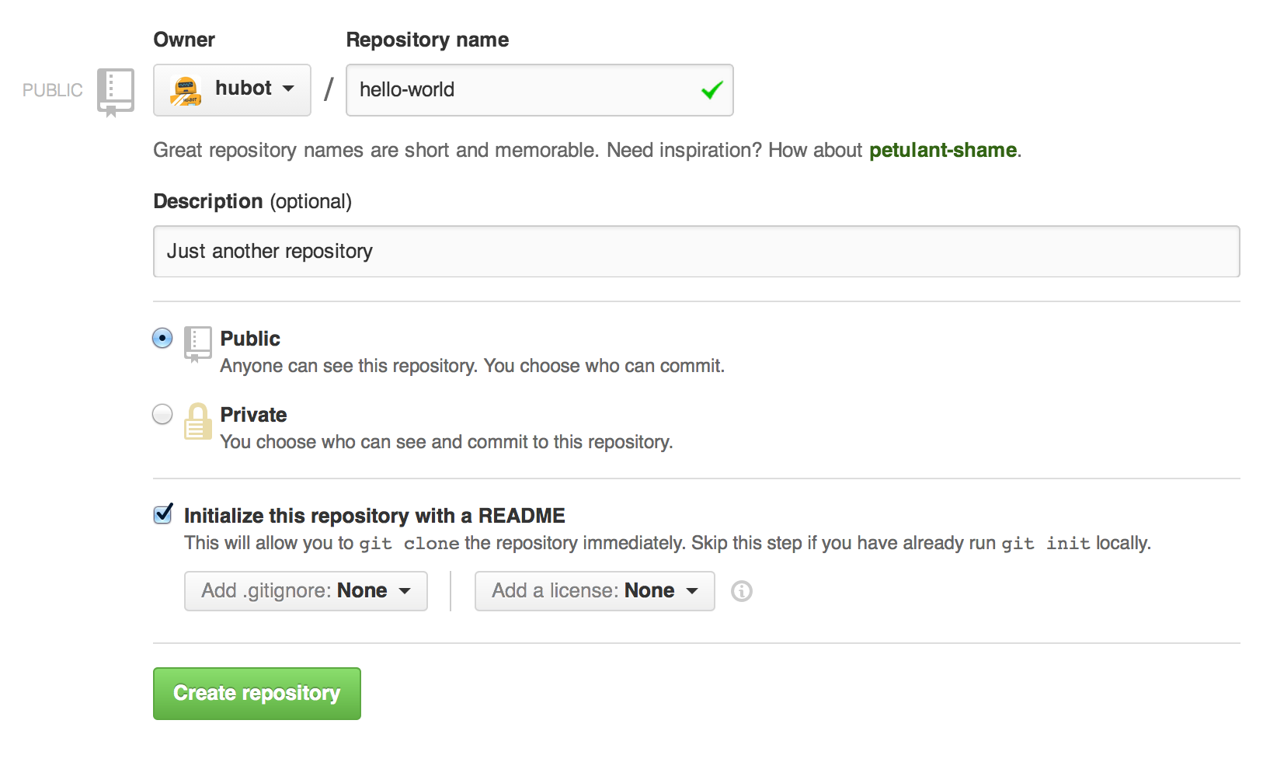
To create a new repository
In the upper right corner, next to your avatar or identicon, click and then select New repository.
Name your repository hello-world.
Write a short description.
Select Initialize this repository with a README.

Slide 11
Create a Branch
Branching is the way to work on different versions of a repository at one time.
By default your repository has one branch named master which is considered to be the definitive branch. We use branches to experiment and make edits before committing them to master.
When you create a branch off the master branch, you’re making a copy, or snapshot, of master as it was at that point in time. If someone else made changes to the master branch while you were working on your branch, you could pull in those updates.
This diagram shows:
The master branch
A new branch called feature (because we’re doing ‘feature work’ on this branch)
The journey that feature takes before it’s merged into master

Slide 12
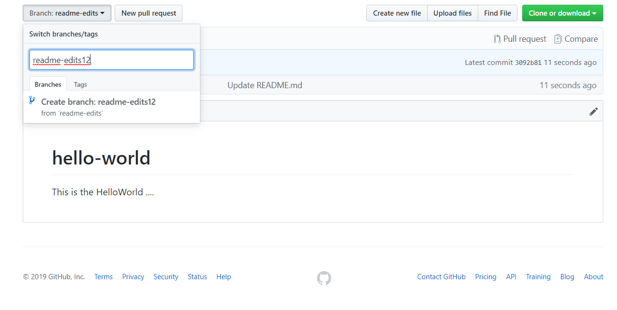
To create a new branch
Go to your new repository hello-world.
Click the drop down at the top of the file list that says branch: master.
Type a branch name, readme-edits, into the new branch text box.
Select the blue Create branch box or hit “Enter” on your keyboard.

Slide 13
Make and commit changes
Click the README.md file.
Click the pencil icon in the upper right corner of the file view to edit.
In the editor, write a bit about yourself.
Write a commit message that describes your changes.
Click Commit changes button.

Slide 14
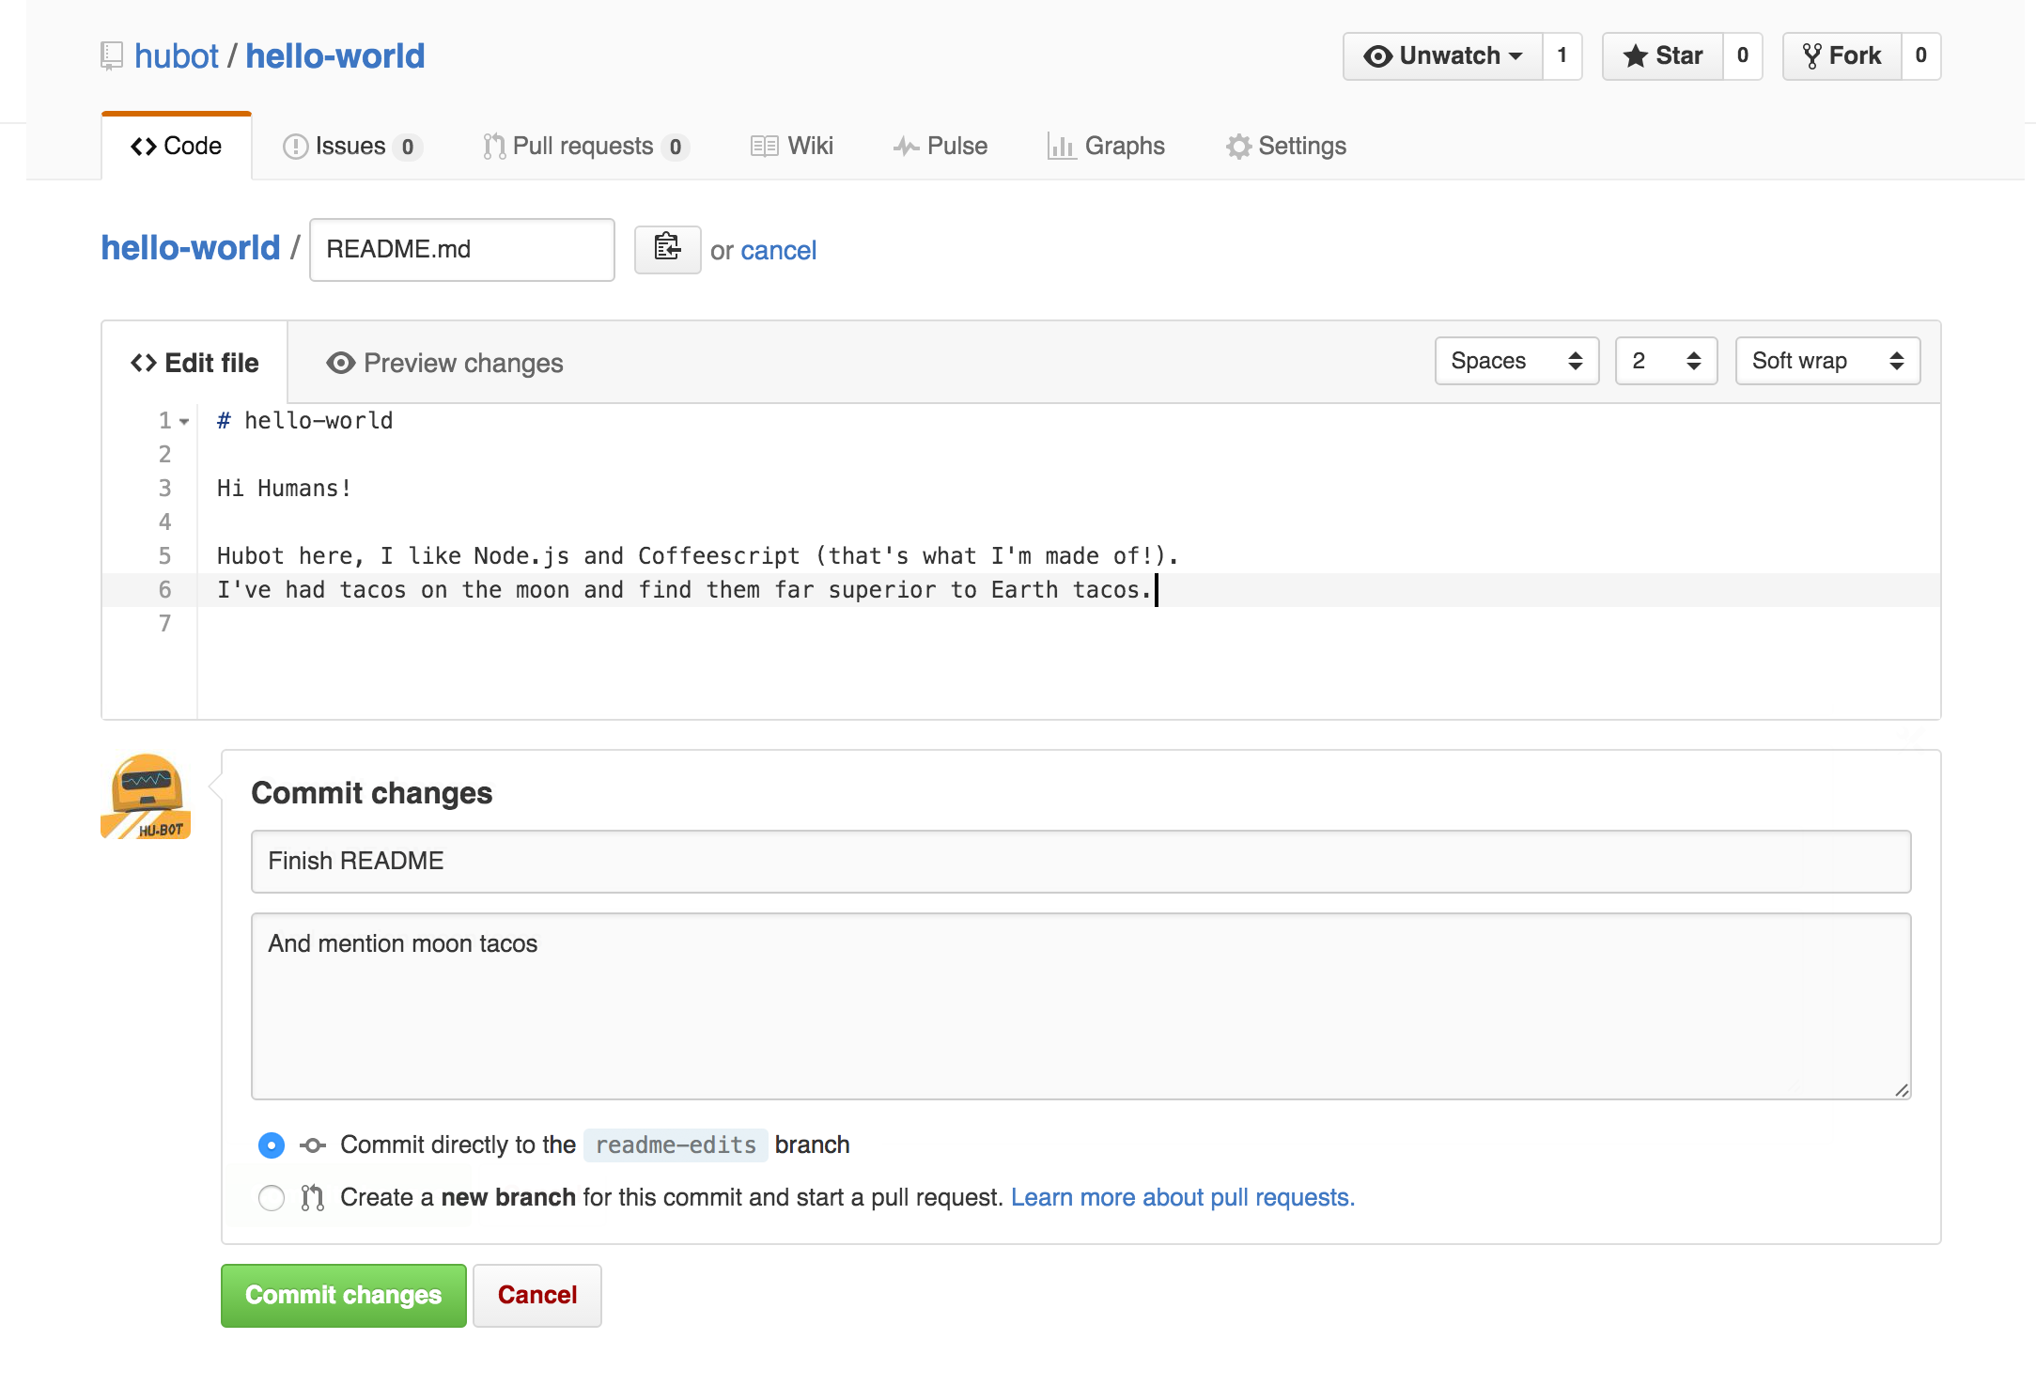
Make and commit changes

Slide 15
Open a Pull Request
Pull Requests are the heart of collaboration on GitHub. When you open a pull request, you’re proposing your changes and requesting that someone review and pull in your contribution and merge them into their branch.
Pull requests show diffs, or differences, of the content from both branches. The changes, additions, and subtractions are shown in green and red.

Slide 16
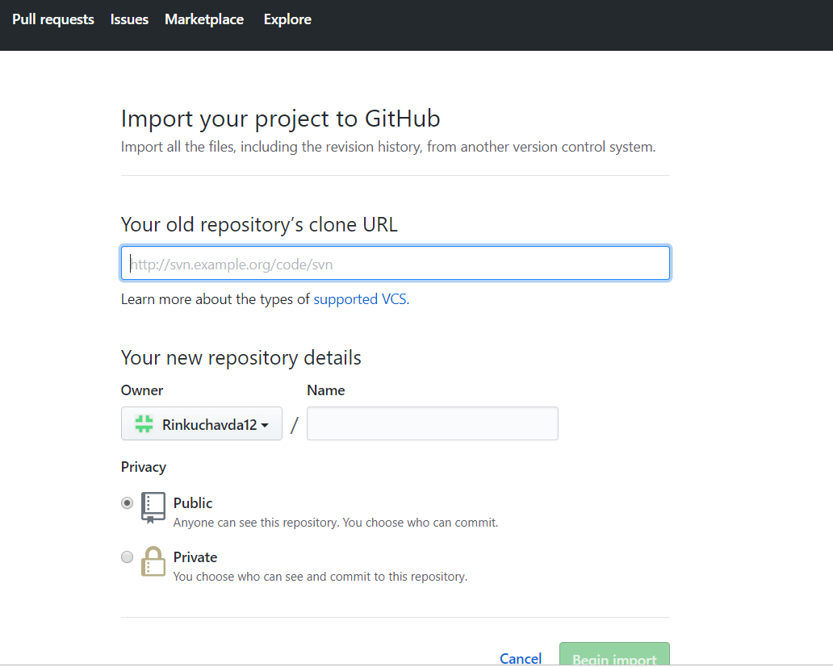
Import Repository to your project

Slide 17
Merge your Pull Request
In this final step, it’s time to bring your changes together – merging your readme-edits branch into the master branch.
Click the green Merge pull request button to merge the changes into master.
Click Confirm merge.
Go ahead and delete the branch, since its changes have been incorporated, with the Delete branch button in the purple box.

Slide 18
Thank you !!!

